Slide 1
Data Structures ICT-1211 Information and Communication Technology
Lecture-25
Date: //2024

Slide 2
TREES

Slide 3
The Heap Data Structure
Def: A heap is a nearly complete binary tree with the following two properties:
Structural property: all levels are full, except possibly the last one, which is filled from left to right
Order (heap) property: for any node x
Parent(x) ≥ x
From the heap property, it follows that:
“The root is the maximum
element of the heap!”
8
7
4
5
2
Heap
A heap is a binary tree that is filled in order

Slide 4
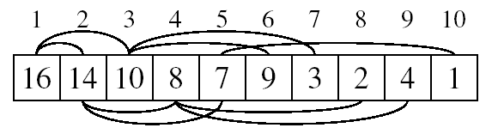
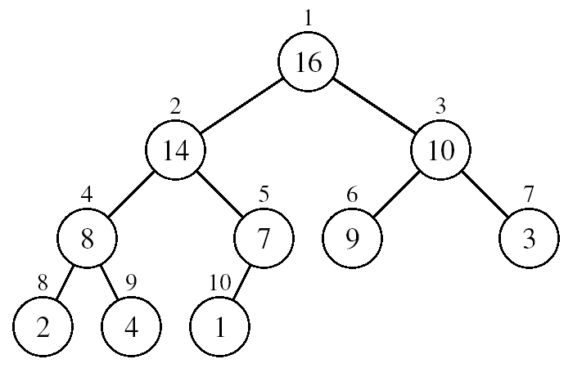
Array Representation of Heaps
A heap can be stored as an array A.
Root of tree is A[1]
Left child of A[i] = A[2i]
Right child of A[i] = A[2i + 1]
Parent of A[i] = A[ ⎣i/2⎦ ]
Heapsize[A] ≤ length[A]
The elements in the subarray A[(⎣n/2⎦+1) .. n] are leaves

Slide 5
Heap
The root of the tree A[1] and given index i of a node, the indices of its parent, left child and right child can be computed
PARENT (i) return floor(i/2) LEFT (i) return 2i RIGHT (i) return 2i + 1

Slide 6
Definition
Max Heap
Store data in ascending order
Has property of
A[Parent(i)] ≥ A[i]
Min Heap
Store data in descending order
Has property of
A[Parent(i)] ≤ A[i]

Slide 7
Max Heap Example
19
12
16
1
4
7
19
12
16
1
4
7
Array A

Slide 8
Min heap example
1
4
16
7
12
19
1
4
16
7
12
19
Array A

Slide 9
Adding/Deleting Nodes
New nodes are always inserted at the bottom level (left to right)
Nodes are removed from the bottom level (right to left)

Slide 10
Operations on Heaps
Maintain/Restore the max-heap property
MAX-HEAPIFY
Create a max-heap from an unordered array
BUILD-MAX-HEAP
Sort an array in place
HEAPSORT

Slide 11
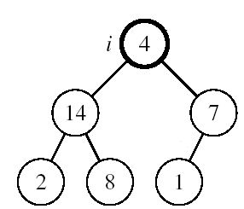
Maintaining the Heap Property
Suppose a node is smaller than a child
Left and Right subtrees of i are max-heaps
To eliminate the violation:
Exchange with larger child
Move down the tree
Continue until node is not smaller than children

Slide 12
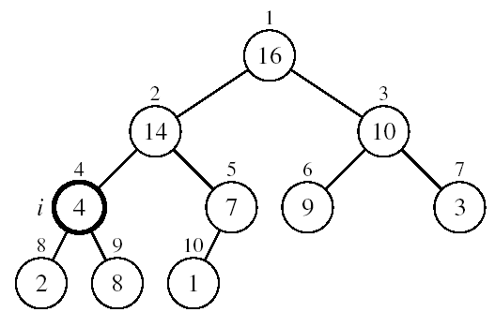
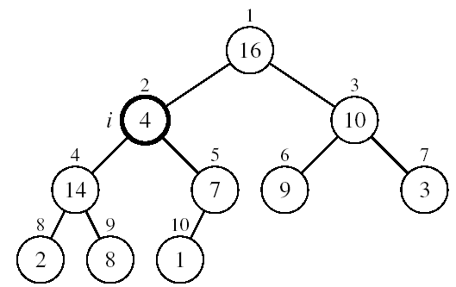
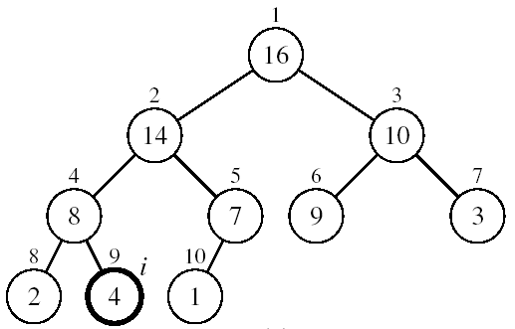
Example
MAX-HEAPIFY(A, 2, 10)
A[2] ↔ A[4]
A[2] violates the heap property
A[4] violates the heap property
A[4] ↔ A[9]
Heap property restored

Slide 13
Insertion
Algorithm
Add the new element to the next available position at the lowest level
Restore the max-heap property if violated
General strategy is percolate up (or bubble up): if the parent of the element is smaller than the element, then interchange the parent and child.
OR
Restore the min-heap property if violated
General strategy is percolate up (or bubble up): if the parent of the element is larger than the element, then interchange the parent and child.

Slide 14
19
19
12
16
12
16
4
7
1
4
7
17
1
Insert 17
19
12
17
swap
1
4
7
16
Percolate up to maintain the heap property

Slide 15
Deletion
Delete max
Copy the last number to the root ( overwrite the maximum element stored there ).
Restore the max heap property by percolate down.
Delete min
Copy the last number to the root ( overwrite the minimum element stored there ).
Restore the min heap property by percolate down.

Slide 16
Heap Sort
A sorting algorithm that works by first organizing the data to be sorted into a special type of binary tree called a heap

Slide 17
Procedures on Heap
Heapify
Build Heap
Heap Sort

Slide 18
Maintaining the Heap Property
Alg: MAX-HEAPIFY(A, i, n)
l ← LEFT(i)
r ← RIGHT(i)
if l ≤ n and A[l] > A[i]
then largest ←l
else largest ←i
if r ≤ n and A[r] > A[largest]
then largest ←r
if largest ≠ i
then exchange A[i] ↔ A[largest]
MAX-HEAPIFY(A, largest, n)
Assumptions:
Left and Right subtrees of i are max-heaps
A[i] may be smaller than its children

Slide 19
Building a Heap
Convert an array A[1 … n] into a max-heap (n = length[A])
The elements in the subarray A[(⎣n/2⎦+1) .. n] are leaves
Apply MAX-HEAPIFY on elements between 1 and ⎣n/2⎦
Alg: BUILD-MAX-HEAP(A)
n = length[A]
for i ← ⎣n/2⎦ downto 1
do MAX-HEAPIFY(A, i, n)
1
4
2
3
1
3
4
5
6
7
2
16
9
10
8
9
10
14
8
7
A:
4 | 1 | 3 | 2 | 16 | 9 | 10 | 14 | 8 | 7

Slide 20
Example: A
4 | 1 | 3 | 2 | 16 | 9 | 10 | 14 | 8 | 7
i = 5
i = 4
i = 3
1
1
1
4
4
4
2
3
2
3
2
3
1
3
1
3
1
3
4
5
6
7
4
5
6
7
4
5
6
7
2
16
9
10
2
16
9
10
14
16
9
10
8
9
10
8
9
10
8
9
10
14
8
7
14
8
7
2
8
7
i = 2
i = 1
1
1
1
4
4
16
2
3
2
3
2
3
1
10
16
10
14
10
4
5
6
7
4
5
6
7
4
5
6
7
14
16
9
3
14
7
9
3
8
7
9
3
8
9
10
8
9
10
8
9
10
2
8
7
2
8
1
2
4
1

Slide 21
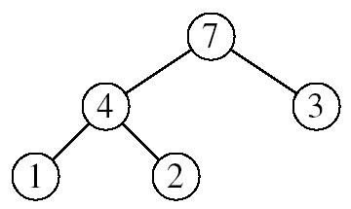
Heapsort
Goal:
Sort an array using heap representations
Idea:
Build a max-heap from the array
Swap the root (the maximum element) with the last element in the array
“Discard” this last node by decreasing the heap size
Call MAX-HEAPIFY on the new root
Repeat this process until only one node remains

Slide 22
Alg: HEAPSORT(A)
BUILD-MAX-HEAP(A)
for i ← length[A] downto 2
do exchange A[1] ↔ A[i]
MAX-HEAPIFY(A, 1, i - 1)

Slide 23
Example: Convert the following array to a heap
16
4
7
1
12
19
Picture the array as a complete binary tree:
16
4
7
1
12
19

Slide 24
16
16
4
7
4
19
swap
12
19
1
12
7
1
16
19
swap
12
19
12
16
swap
4
7
1
4
7
1

Slide 25
Heap Sort
The heapsort algorithm consists of two phases: - build a heap from an arbitrary array - use the heap to sort the data
To sort the elements in the decreasing order, use a min heap
To sort the elements in the increasing order, use a max heap
19
12
16
1
4
7

Slide 26
Example of Heap Sort
Take out biggest
19
12
16
Move the last element
to the root
1
4
7
Sorted:
Array A
12
16
1
4
7
19

Slide 27
7
swap
HEAPIFY()
12
16
1
4
Sorted:
Array A
7
12
16
1
4
19

Slide 28
16
12
7
1
4
Sorted:
Array A
16
12
7
1
4
19

Slide 29
Take out biggest
16
Move the last element
to the root
12
7
1
4
Sorted:
Array A
12
7
1
4
16
19

Slide 30
4
12
7
1
Sorted:
Array A
4
12
7
1
16
19

Slide 31
swap
4
HEAPIFY()
12
7
1
Sorted:
Array A
4
12
7
1
16
19

Slide 32
12
4
7
1
Sorted:
Array A
12
4
7
1
16
19

Slide 33
Take out biggest
12
Move the last
element to the
root
4
7
1
Sorted:
Array A
4
7
1
12
16
19

Slide 34
1
swap
4
7
Sorted:
Array A
1
4
7
12
16
19

Slide 35
7
4
1
Sorted:
Array A
7
4
1
12
16
19

Slide 36
Take out biggest
7
Move the last
element to the
root
4
1
Sorted:
Array A
1
4
7
12
16
19

Slide 37
swap
1
HEAPIFY()
4
Sorted:
Array A
4
1
7
12
16
19

Slide 38
Take out biggest
Move the last
element to the
root
4
1
Sorted:
Array A
1
4
7
12
16
19

Slide 39
Take out biggest
1
Sorted:
Array A
1
4
7
12
16
19

Slide 40
Sorted:
1
4
7
12
16
19

Slide 41
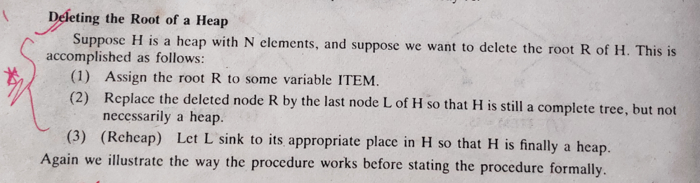
Heap sort

Slide 42
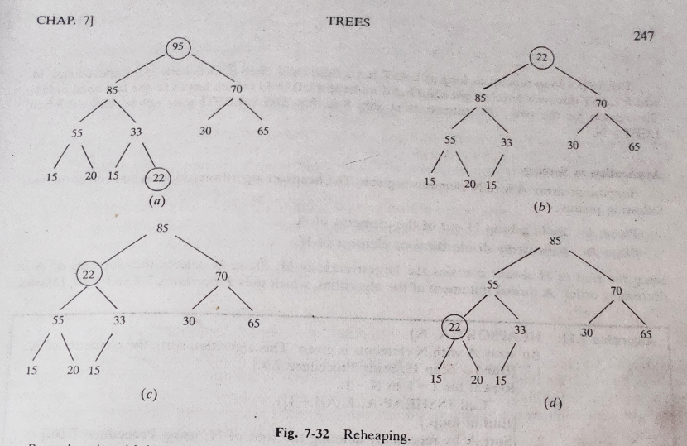
Heap sort

Slide 43
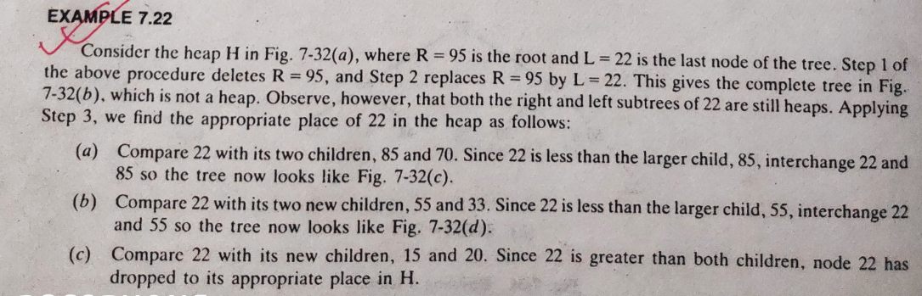
Heap sort

Slide 44
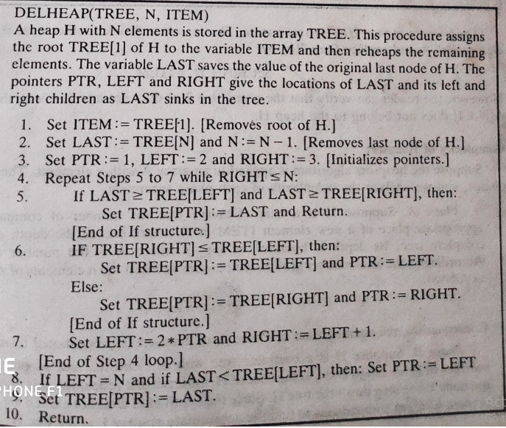
Heap sort

Slide 45
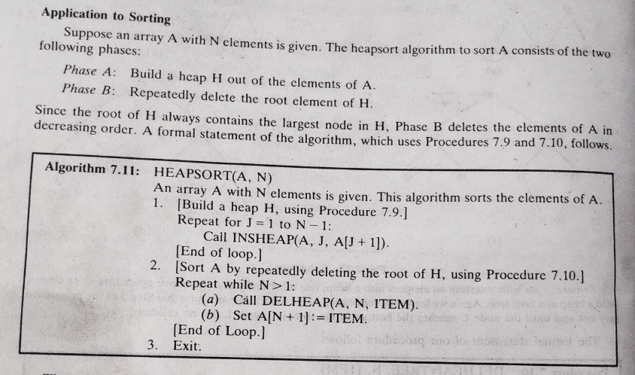
Heap sort

Slide 46
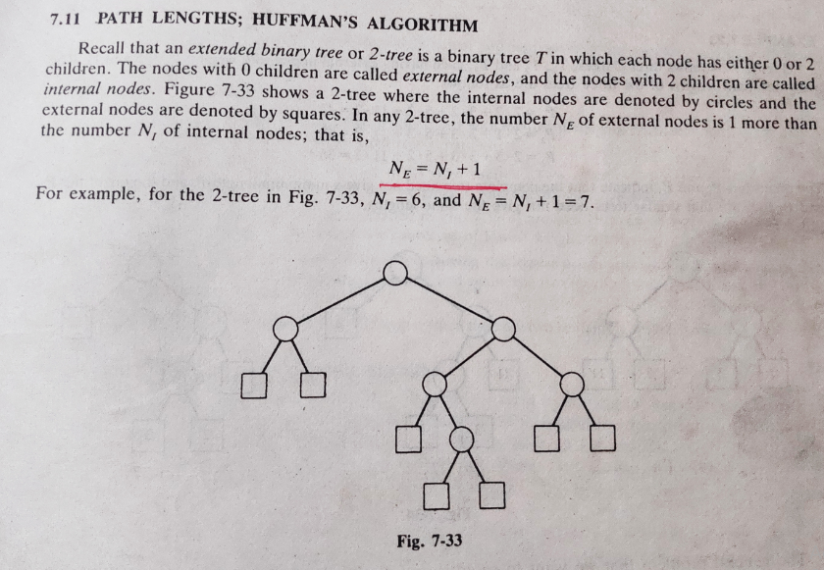
Huffman Algorithm

Slide 47
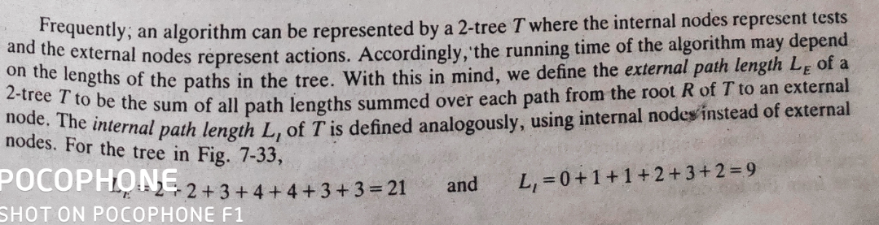
Huffman Algorithm

Slide 48
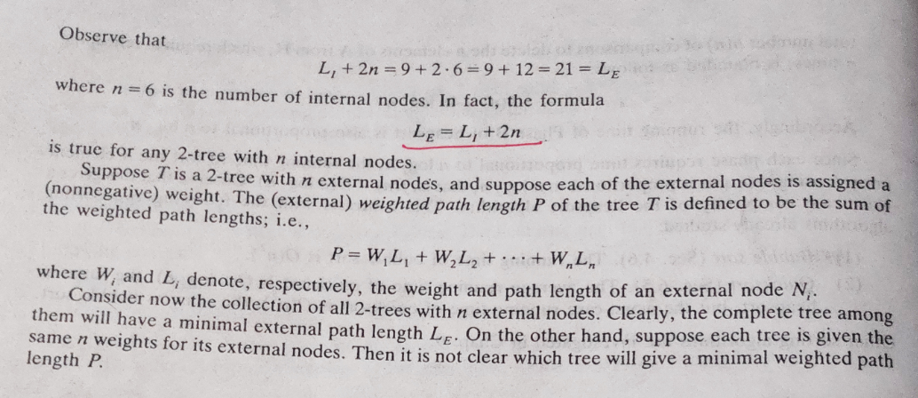
Huffman Algorithm

Slide 49
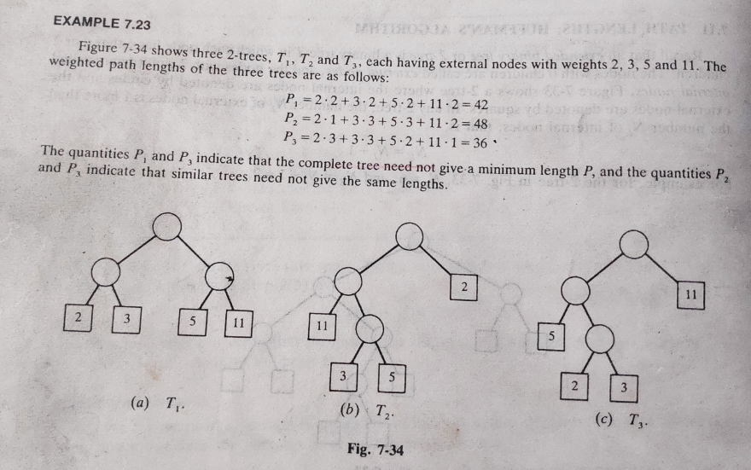
Huffman Algorithm

Slide 50
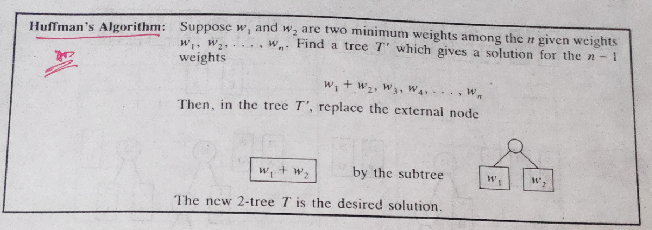
Huffman Algorithm

Slide 51
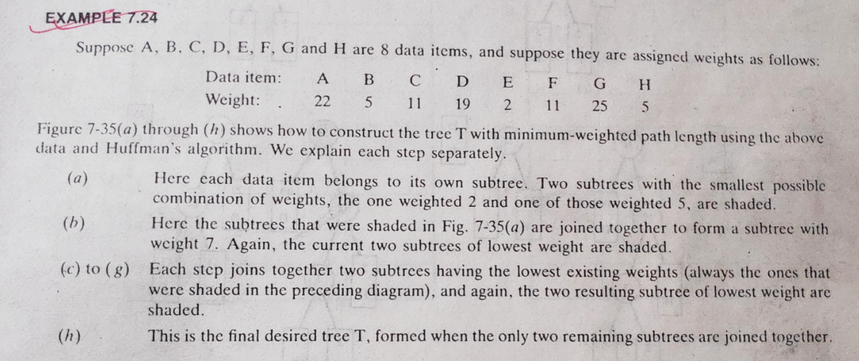
Huffman Algorithm

Slide 52
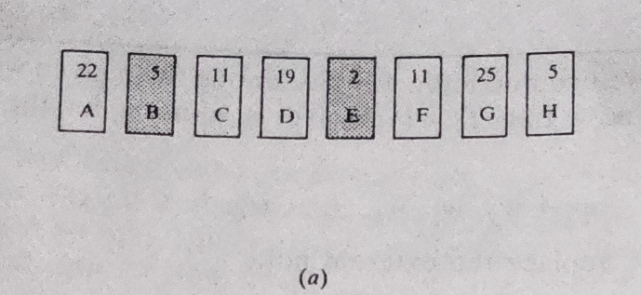
Huffman Algorithm

Slide 53
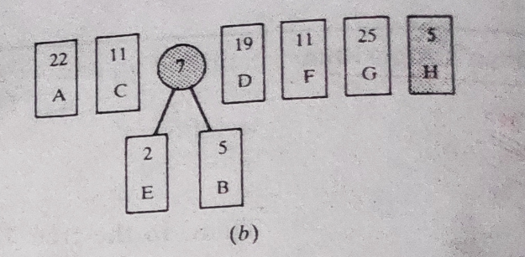
Huffman Algorithm

Slide 54
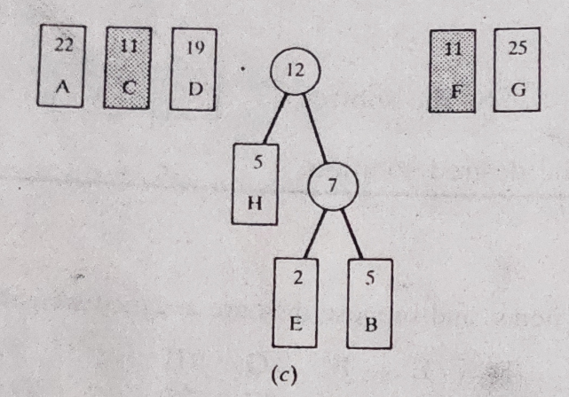
Huffman Algorithm

Slide 55
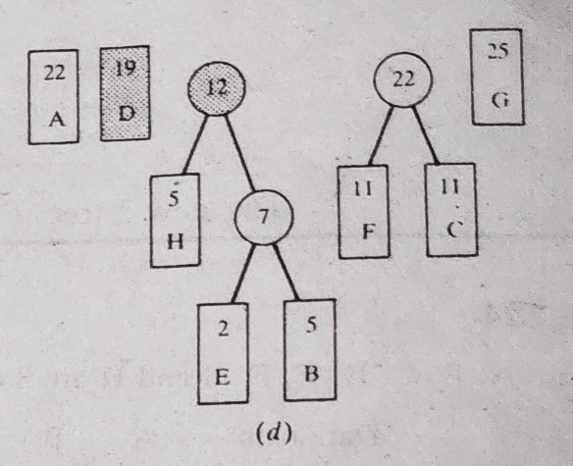
Huffman Algorithm

Slide 56
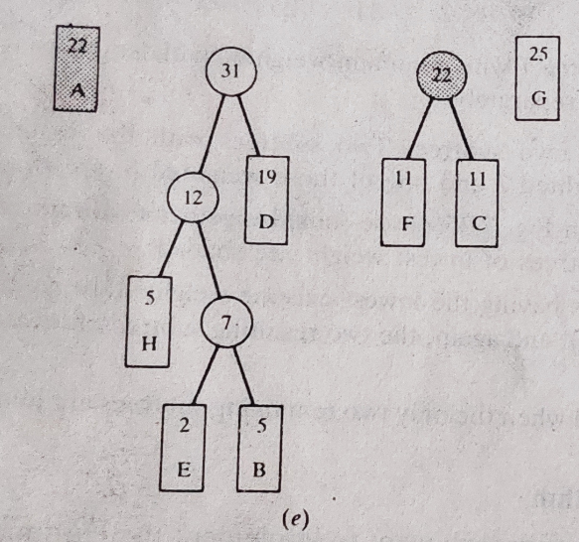
Huffman Algorithm

Slide 57
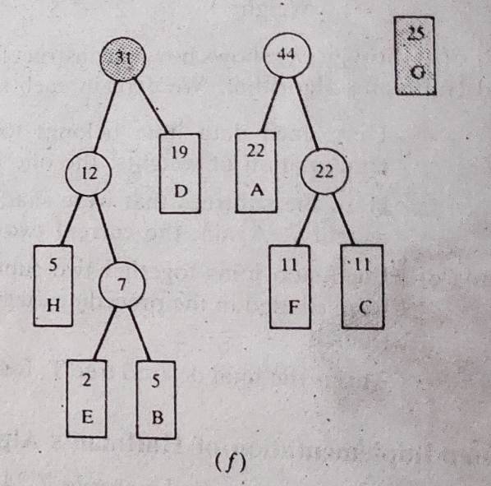
Huffman Algorithm

Slide 58
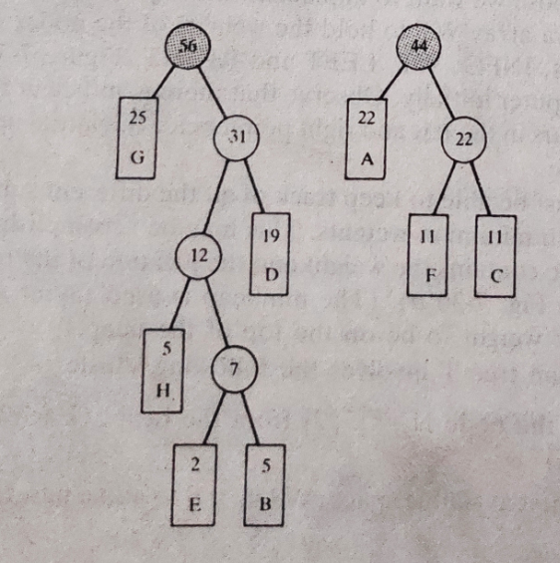
Huffman Algorithm

Slide 59
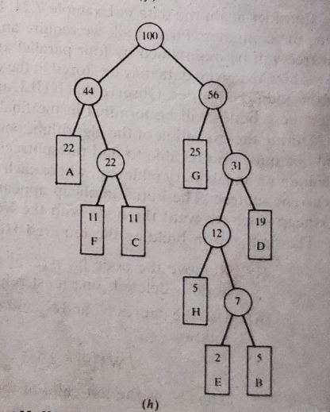
Huffman Algorithm

Slide 60
Thank you……

